Slide 1

SDM COLLEGE OF ENGINEERING AND TECHNOLOGY, DHARWAD-580002
Optical Character Recognition using Neural-Networks
Team:
Madhusoodan M Pataki 2SD14CS054
Anarghya Jantali 2SD14CS128
Guide:
Prof. Sharada H. N.

Slide 2
Content
Objectives
Literature survey
What motivates us for this.
Methodologies
Limitations
Outcomes
References

Slide 3
Objectives
To develop a software that can recognize the characters of English language in a sample image and can output the characters in the form of string in a text file.
Scope
Input to the software is through an image in a bmp, png, jpg image files.
The input image can consist only of English language printed characters and digits.

Slide 4
Literature Survey
Dinesh Dileep et al, "A feature extraction technique based on character geometry for character recognition“ This paper describes a geometry based technique for feature extraction for segmentation based recognizing systems.
M. Zahid Hossain M. et al. “Rapid Feature Extraction for Optical Character Recognition” This paper describes the different feature extraction methods and algorithms.
Simon Haykin “Neural Networks - A Comprehensive Foundation” This book has immense explanation on Neural Networks.

Slide 5
Motivation
Input image once converted to a digital format helps in storage, processing by which numerous useful applications can be developed such as
Reading of forms such as cheques, postal-codes etc.
Digitizing paper form documents.
It can be augmented with an intelligent interpreter for evaluation of answer scripts.
It can be used as a source for voice interpreters, translations.
Registration of vehicle numbers in tolls, parking lots.

Slide 6
How it works
There are two phases in the working of our OCR model (generally in every model).
Learning phase
Working/Test phase.

Slide 7
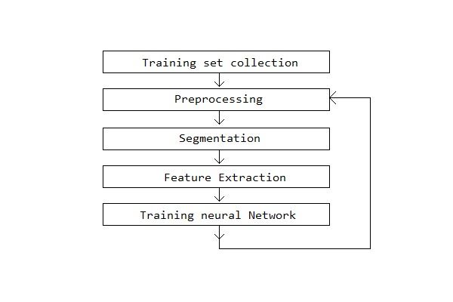
1. Learning Phase
Image set collection
Pre-Processing
Segmentation
Feature Extraction
Training

Slide 8
1.1 Image set collection
Here we collect different set of inputs, and label them with expected output.
More varied the training set, better the recognition, in working phase.
Criteria for selection
Noisy images
Skewed Images.
Simple but different fonts
Different sized fonts

Slide 9
1.2 Preprocessing
Noise-Removal Images captured on camera have noise in them, they may cause inaccuracies, hence noise removal is done.
Skew detection and correction Scanning horizontally becomes a problem and may cause Inaccuracies, hence detection and correction are necessary.
Binarization To differentiate foreground text from background binarization is done.

Slide 10
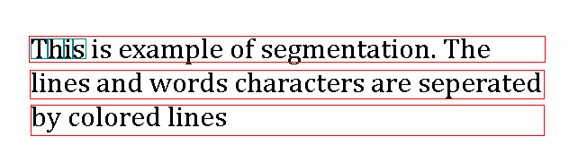
1.3 Segmentation
Given input image, it is segmented in lines, words and characters. Segmented characters are input to feature extraction step.

Slide 11
1.4 Feature Extraction
From each segment of the image, features are extracted which are to be used as input for ANN. This is the most critical part of this approach. We are not yet clear which FE method to use as there are lot of them such as.
Crossing.
Nearest neighbor.
Zoning.
Structural components with connectivity graph.

Slide 12
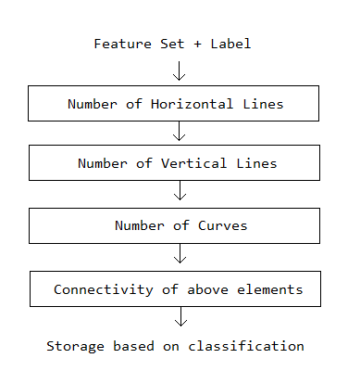
1.5 Training by Classification
The Neural network designed is a multilayer feed-forward classifier. They observe matching between a feature input and mapped output.
Classification example
Notes:
The Neural Network is trained for recognizing the characters in this phase. This phase contains sequences of the processes, that are unique so as to enable Neural-network to learn from the test set.

Slide 13
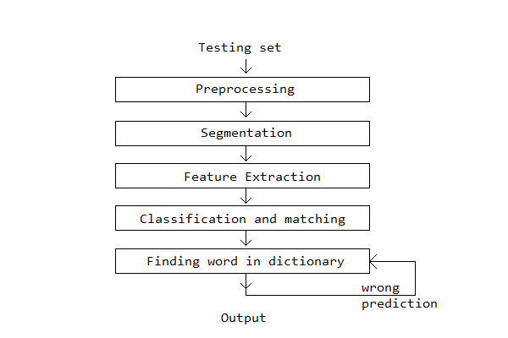
2. Working phase
Here the neural network identifies the characters in the given image. Many of the steps in this phase are similar to them in Learning phase.

Slide 14
2.4 Classification and matching
In this phase the features of test image is matched with the set of features stored with features in learning phase.
The output of this phase is biased by the learning set’s diversity.

Slide 15
2.5 Finding the word in dictionary
The outputs of the matching phase are used to create words and are tried to match with words in the dictionary.
This step helps in removing ambiguities when an image is matched to multiple characters with almost same probability.

Slide 16
Implementation details & Requirements
Will be Programmed in : Java.
System Requirements.
PC with minimum 2GB RAM, 1GB free disk-space
Windows, Linux, MAC with JRE7 and above

Slide 17
Limitations
Limited to some simple fonts.
Accuracy is not so good for noisy and skewed images.
Non reusable NN as built for specific application.

Slide 18
Student specific outcomes
While doing this project we try to learn.
Some Image Processing techniques.
Different Feature extraction methods.
Neural Networks.

Slide 19
Project specific outcomes
Project Outcomes:
A standalone trained Neural Network library which can be used for development of smart applications such as.
Document Digitizer.
A book reader for blind people when some books are not converted to brail script.
Number plate scanner for the Tolls.
An codebase to learn Neural Networks and OCR better.

Slide 20
References…
[1]. “Pattern Recognition and Machine Learning” by Cristopher M. Bishop. ISBN-13:978-0387-31073-2 Springer Science and Business Media LLC.
[2]. Seethalakshmi R et al. “Optical Character Recognition for printed Tamil text using Unicode”. Journal of Zhejiang University SCIENCE ISSN 1009-3095
[3]. Usha Tiwari et al. “Text Extraction from Images”. International Journal of Electronic and Electrical Engineering. ISSN 0974-2174Volume 7, Number 9 (2014), pp. 979-985
[4]. Sandhya Arora et al. “Combining Multiple Feature Extraction Techniques for Handwritten Devanagari Character Recognition” 2008 IEEE Region 10 Colloquium and the Third ICIIS, Kharagpur, India

Slide 21
…References...
[5]. Gaurav Y. Tawde, and Jayashree M. K. International Journal of Engineering Research and Applications (IJERA) ISSN: 2248-9622
[6]. Rafael C. Gonzalez, Richard E. woods and Steven L. Eddins. Digital Image Processing, Pearson Education, Dorling Kindersley, South Asia, 2004.
[7]. Anil.K.Jain and Torfinn Taxt, “Feature extraction methods for character recognition-A Survey” Pattern Recognition, vol. 29, no. 4, pp. 641-662, 1996
[8]. C. L. Liu, H. Fujisawa, “Classification and Learning for Character Recognition : Comparison of Methods and Remaining Problems”, Int. Workshop on Neural Networks and Learning in Document Analysis and Recognition, Seoul, 2005.

Slide 22
…References
[9]. J Pradeep et al. "Diagonal based feature extraction for handwritten characters", International Journal of Computer Science & Information Technology (IJCSIT), Vol 3, No 1, Feb 2011
[10]. Dinesh Dileep et al. "A feature extraction technique based on character geometry for character recognition", International Journal of Advanced Research in Computer Science and Software Engineering, Vol. 2,2014.
[11]. M. Zahid Hossain et al. “Rapid Feature Extraction for Optical Character Recognition”

Slide 23
Thanks for your time.

